Slide 1
CSCI-B657: Computer Vision
Image Detection Utilizing YOLO
Ethan Eldridge
Gavin Hemmerlein
INDIANA UNIVERSITY

Slide 2
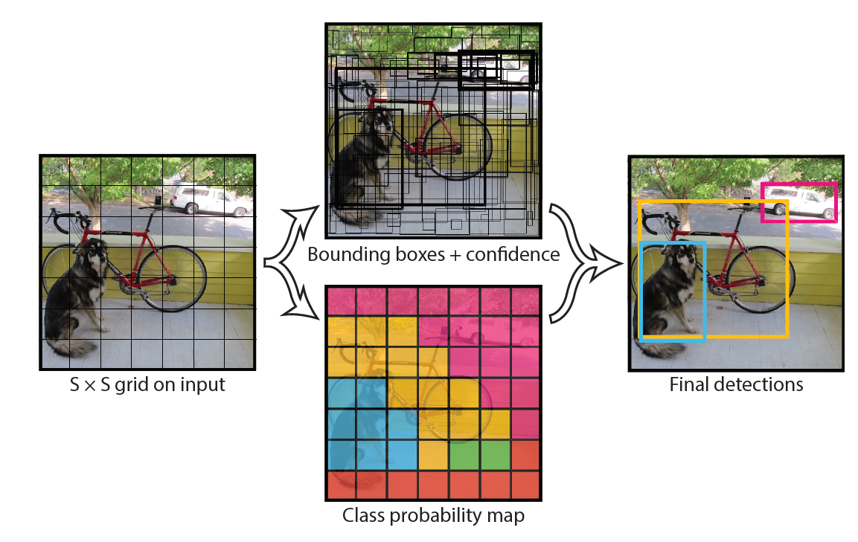
Unified, Real-Time Object Detection
You Only Look Once
Rebounds detection to a regression problem with bounding boxes
Segments the image into a map with classification probabilities
The algorithm is extremely fast!
Figure 2: The Model (J. Redmon, et al.)

Slide 3
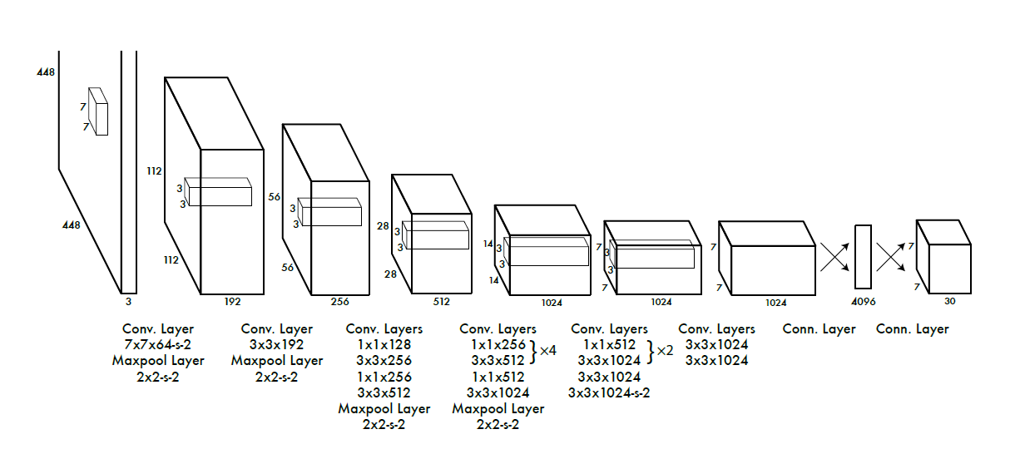
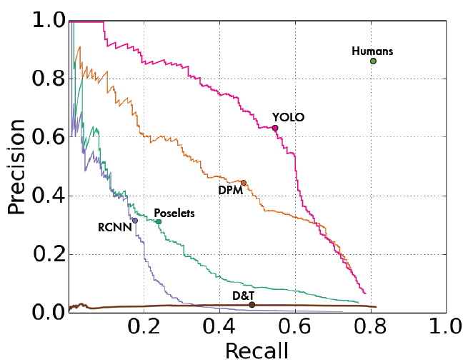
Unified, Real-Time Object Detection
You Only Look Once
Contains 24 convolutional layers
Goal to have confidence level of bounding box equal to intersection over union (IOU)
The algorithm is very precise when well trained such as on Picasso
Figure 3: Neural Network Architecture (J. Redmon, et al.)
Picasso Dataset Precision Recall Curve (J. Redmon, et al.)

Slide 4
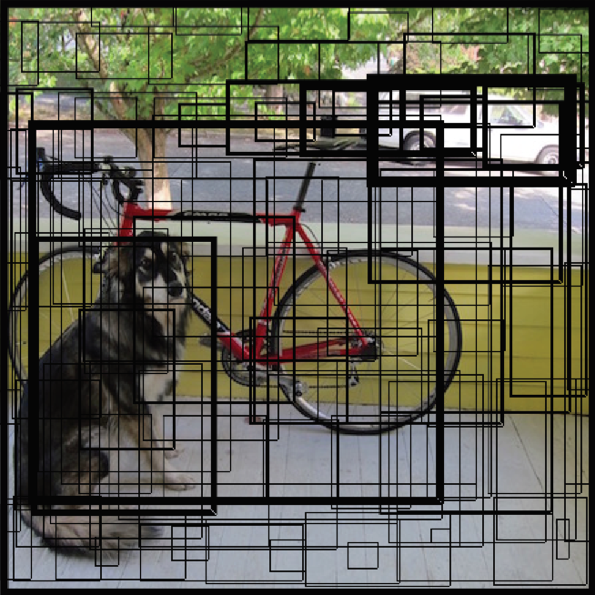
Bounding
Bounding Regions Used in YOLO
The regions are calculated quickly
Multiple calculations made to produce the detection
Bounding Boxes
(Figure 2: J. Redmon, et al.)

Slide 5
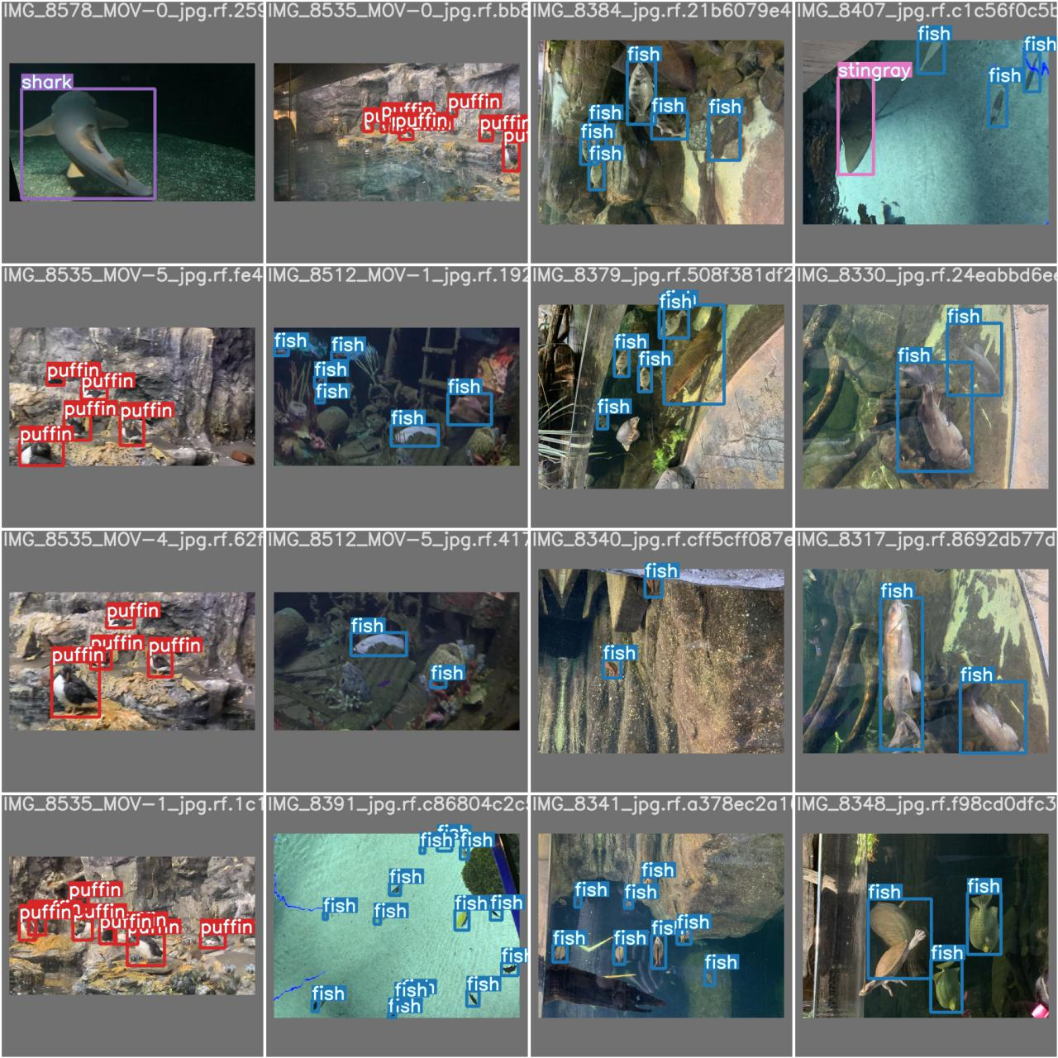
Aquarium Training
Training on Datasets
Roboflow has a plethora of datasets
Aquarium is one of the largest (416 images)

Slide 6
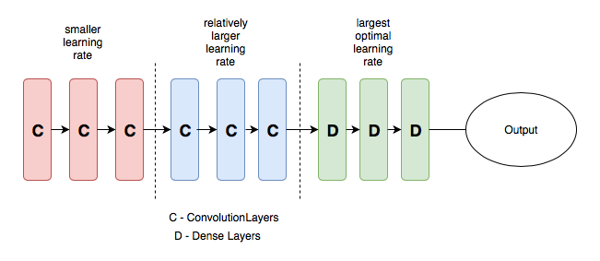

Optimization
α – The Learning Rate
By modifying the learning rate, we can modify the results of our algorithm! This is powerful, but it is not without fault.
The YOLO config file has a low learning rate (0.01). This was the rate recommended by Ultralytics.
Learning rates throughout convolutional layers
Learning Rate Relations of Loss
Notes:
Pulled the picture from:
https://towardsdatascience.com/understanding-learning-rates-and-how-it-improves-performance-in-deep-learning-d0d4059c1c10

Slide 7
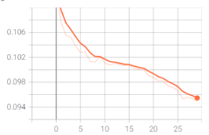
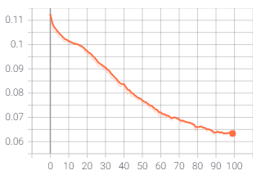
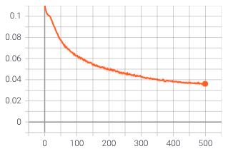
Loss Plots
Results of Modifications
After modifying the epochs, the team saw significant changes in the loss curve. The results can be seen below.
Box Loss Curves
Results from 30 Epoch
Results from 100 Epoch
Results from 500 Epoch

Slide 8
Bounding
Lessons Learned
Training is by far the most burdensome portion of YOLO.
Utilizing previously trained weights saves time, but likely will lose accuracy in the execution
The loss curve needs enough runs to result in a lower loss

Slide 9
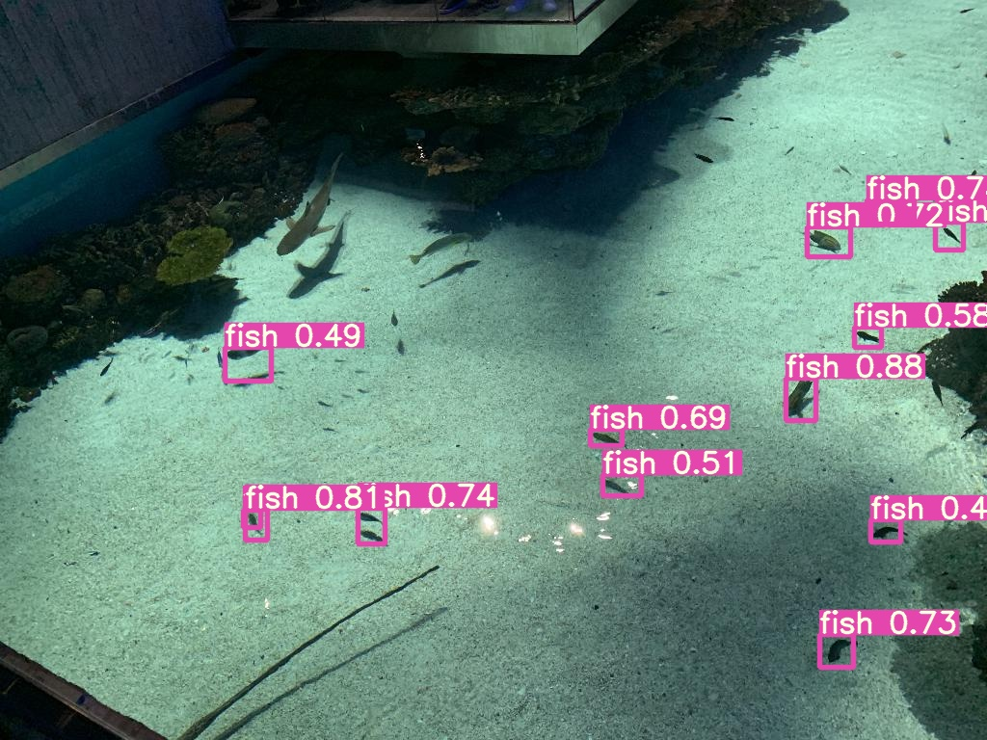
Classification using our trained model
Fish Probability Detection

Slide 10
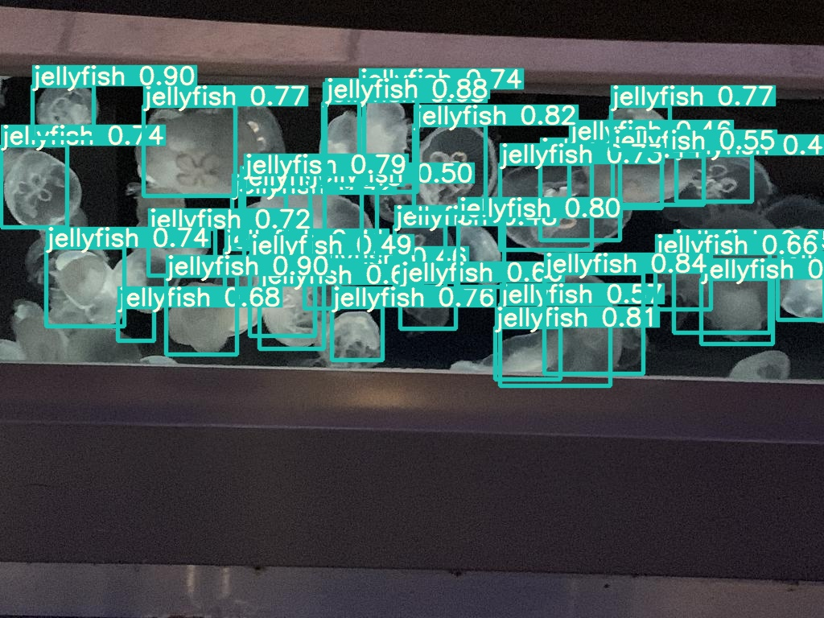
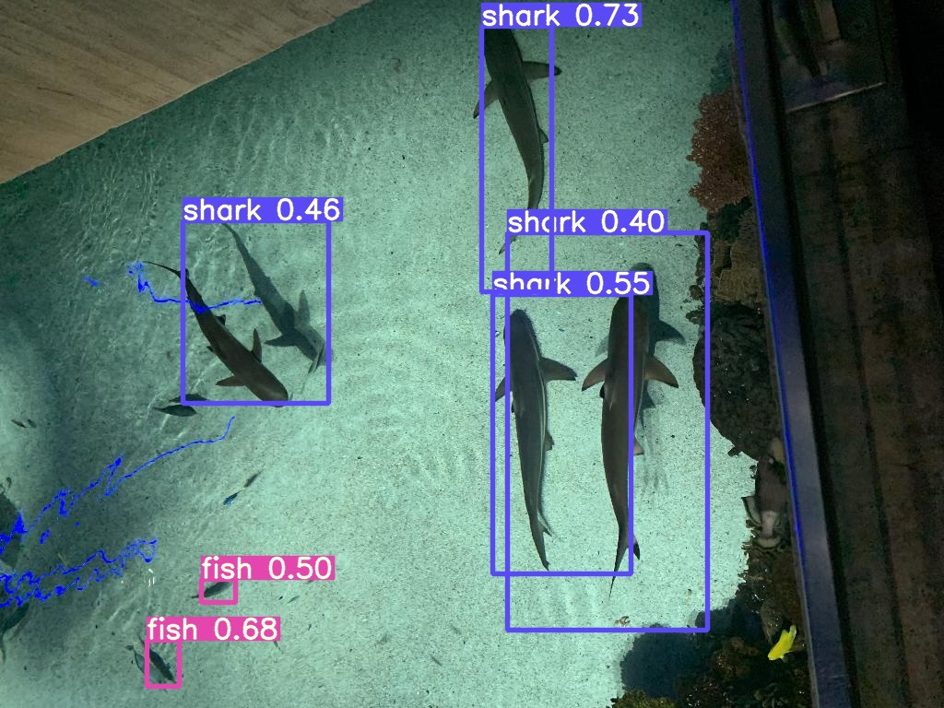
Handles Clutter Surprisingly Well!
Multiple Categories Possible to Detect

Slide 11
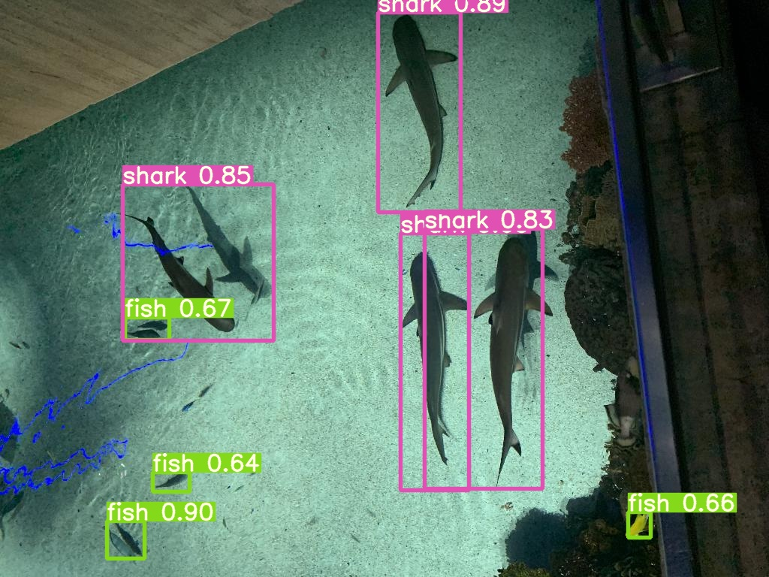
Image of Shark and Fish at 100 Epochs (some fish remain unclassified).
Image of Shark and Fish at 500 Epochs (higher confidence, more fish identified).

Slide 12
Optimization
YOLO Future Improvements
Video Algorithm – Implementation examples available. Increased area of study
Bounding Regions – Not ideal, but not a problem
Other Observations
Clutter is (sometimes) a problem

Slide 13
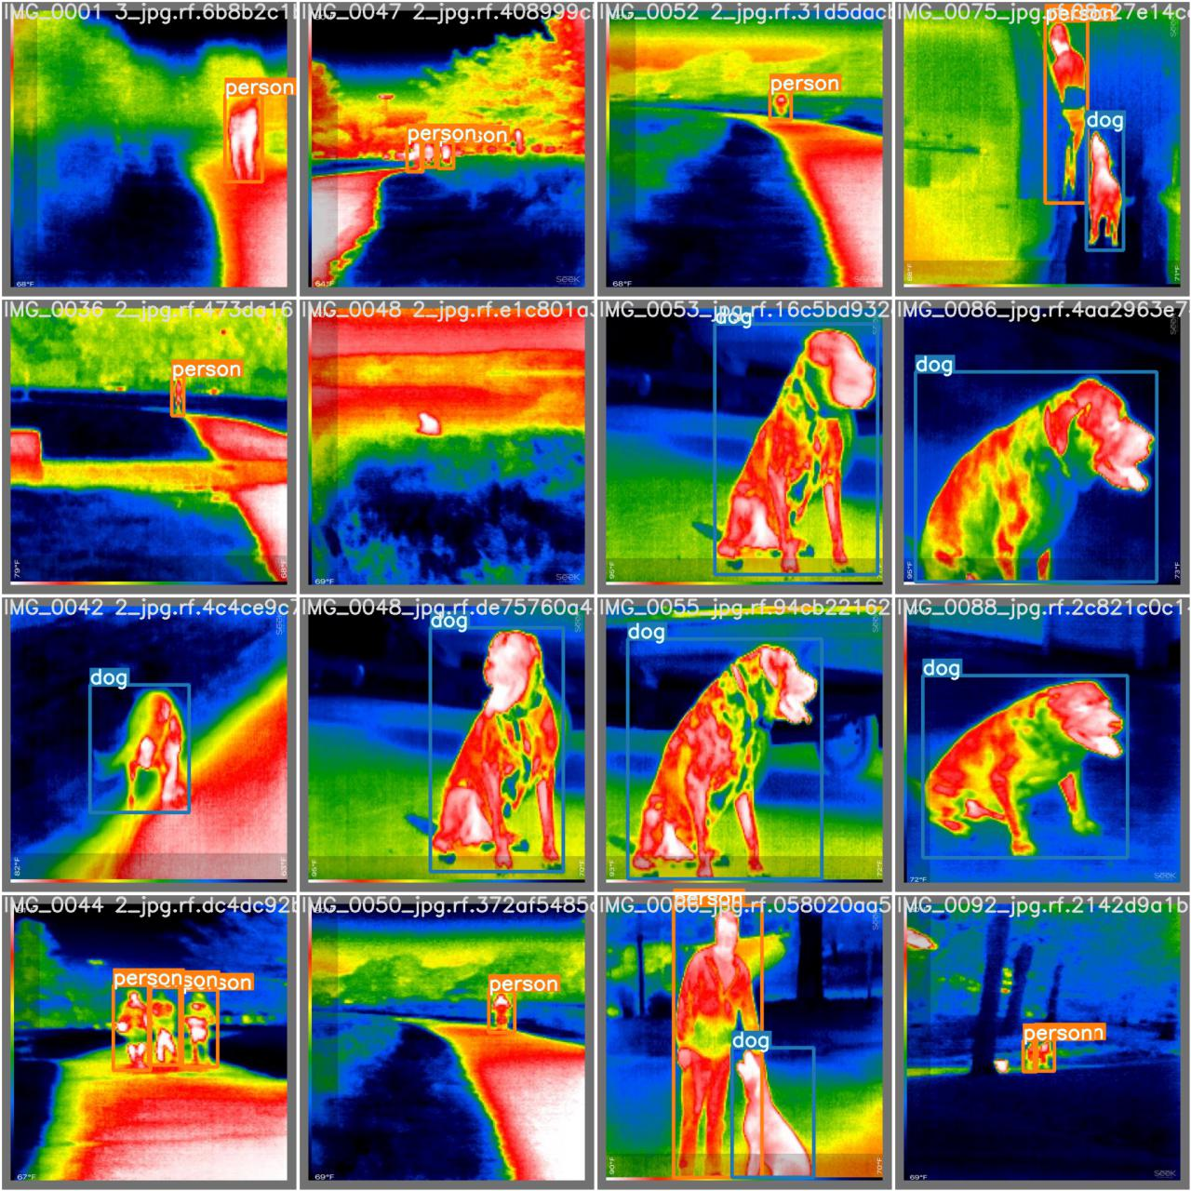
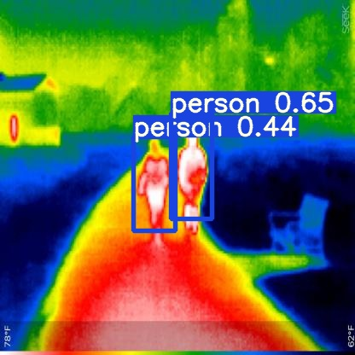
Other Datasets – Vehicles
Classification
Multiple Person Detection

Slide 14
Special Thanks
Thank you
Dr. Reza and the CSCI B657 course staff
Paper Authors for YOLOv1 through YOLOv5
Roboflow for use of their datasets and availability of tutorials

